Slide 1

Urban Renewal and Decay
Luiz Vasconcelos, Stephen Sheetz, Eric Kuha

Slide 2
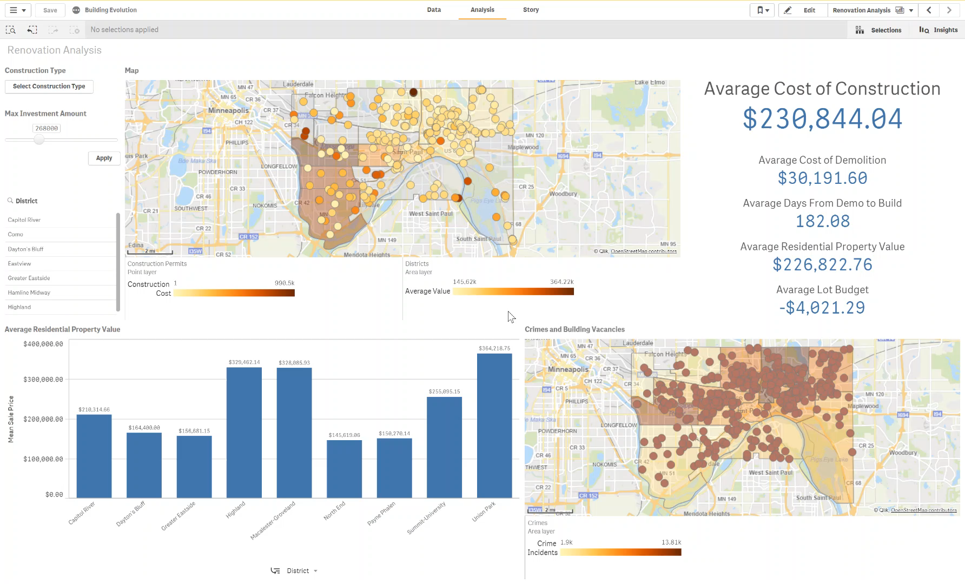

Slide 3
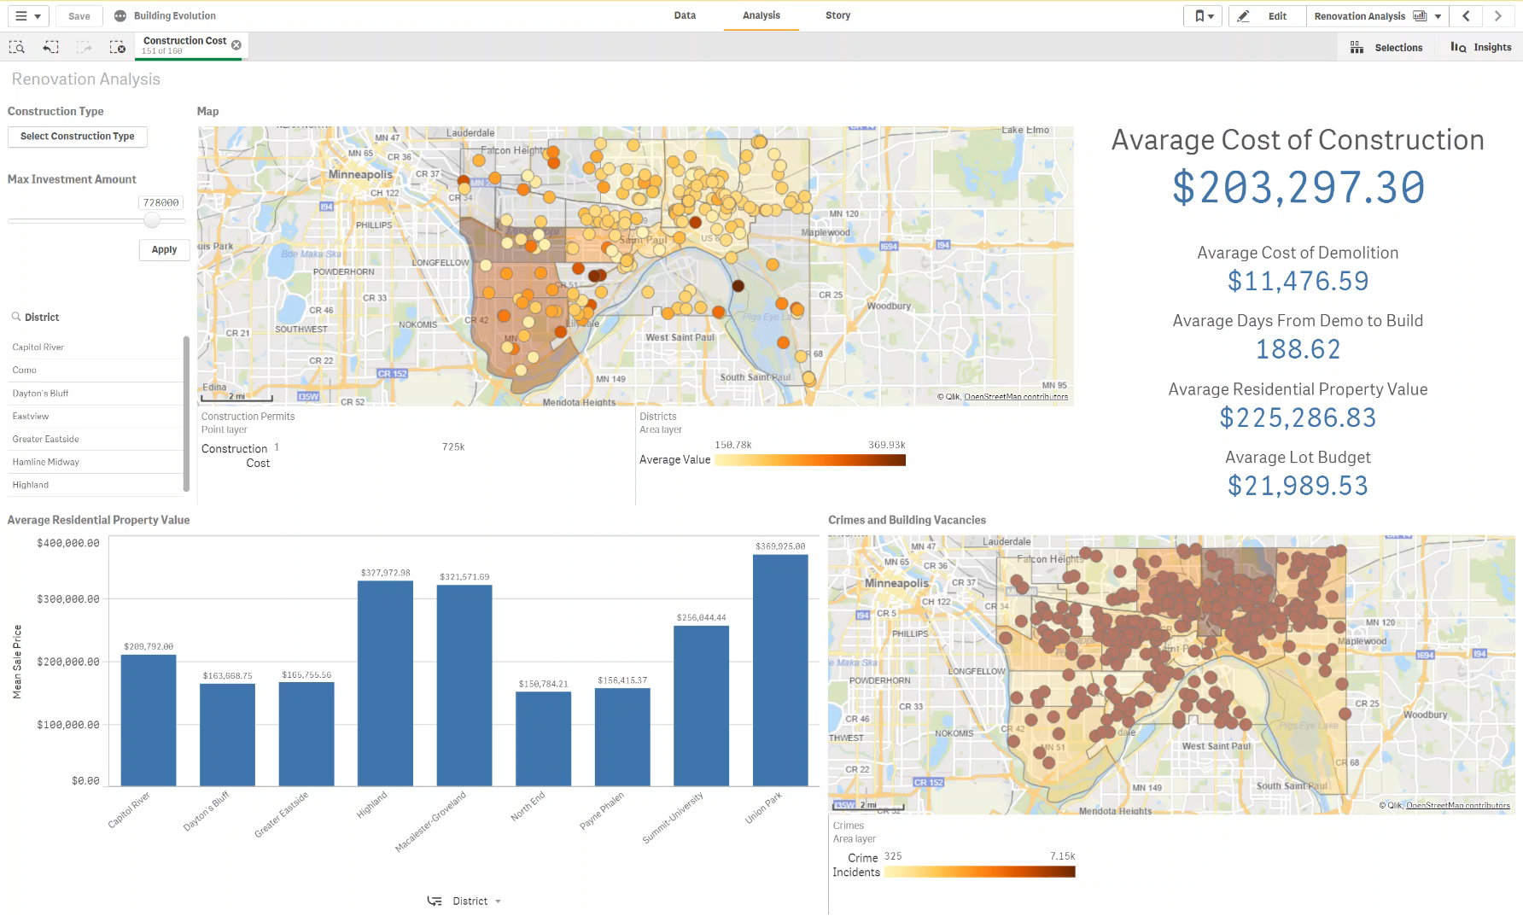
Highland Construction Projects

Slide 4
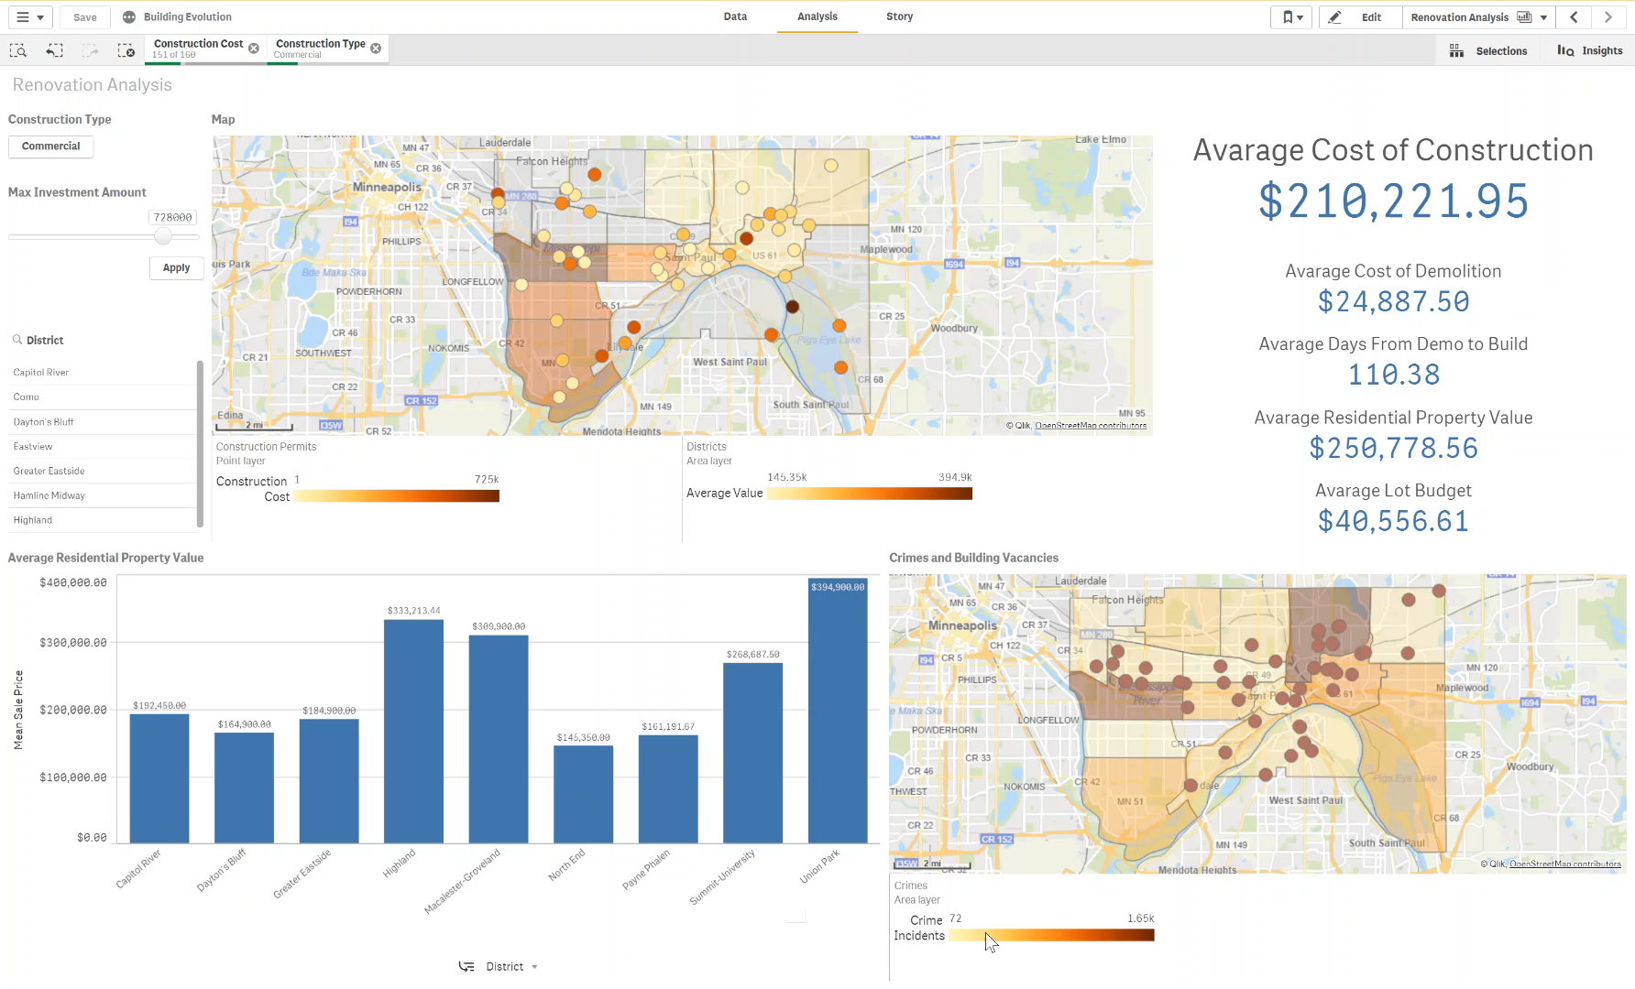
Comparing two districts

Slide 5
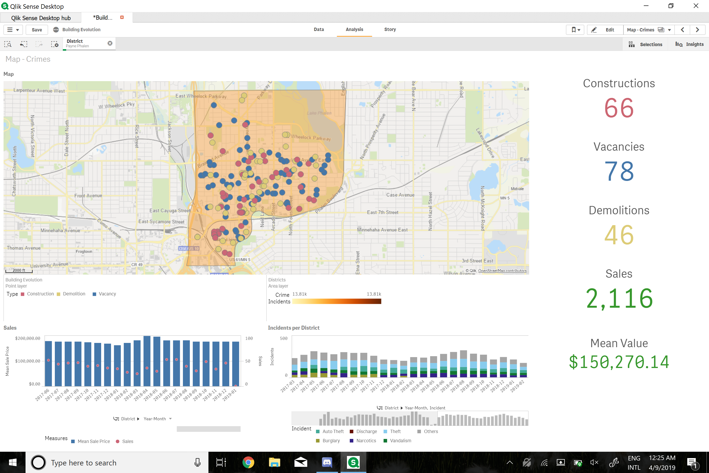
Crime Data by District

Slide 6
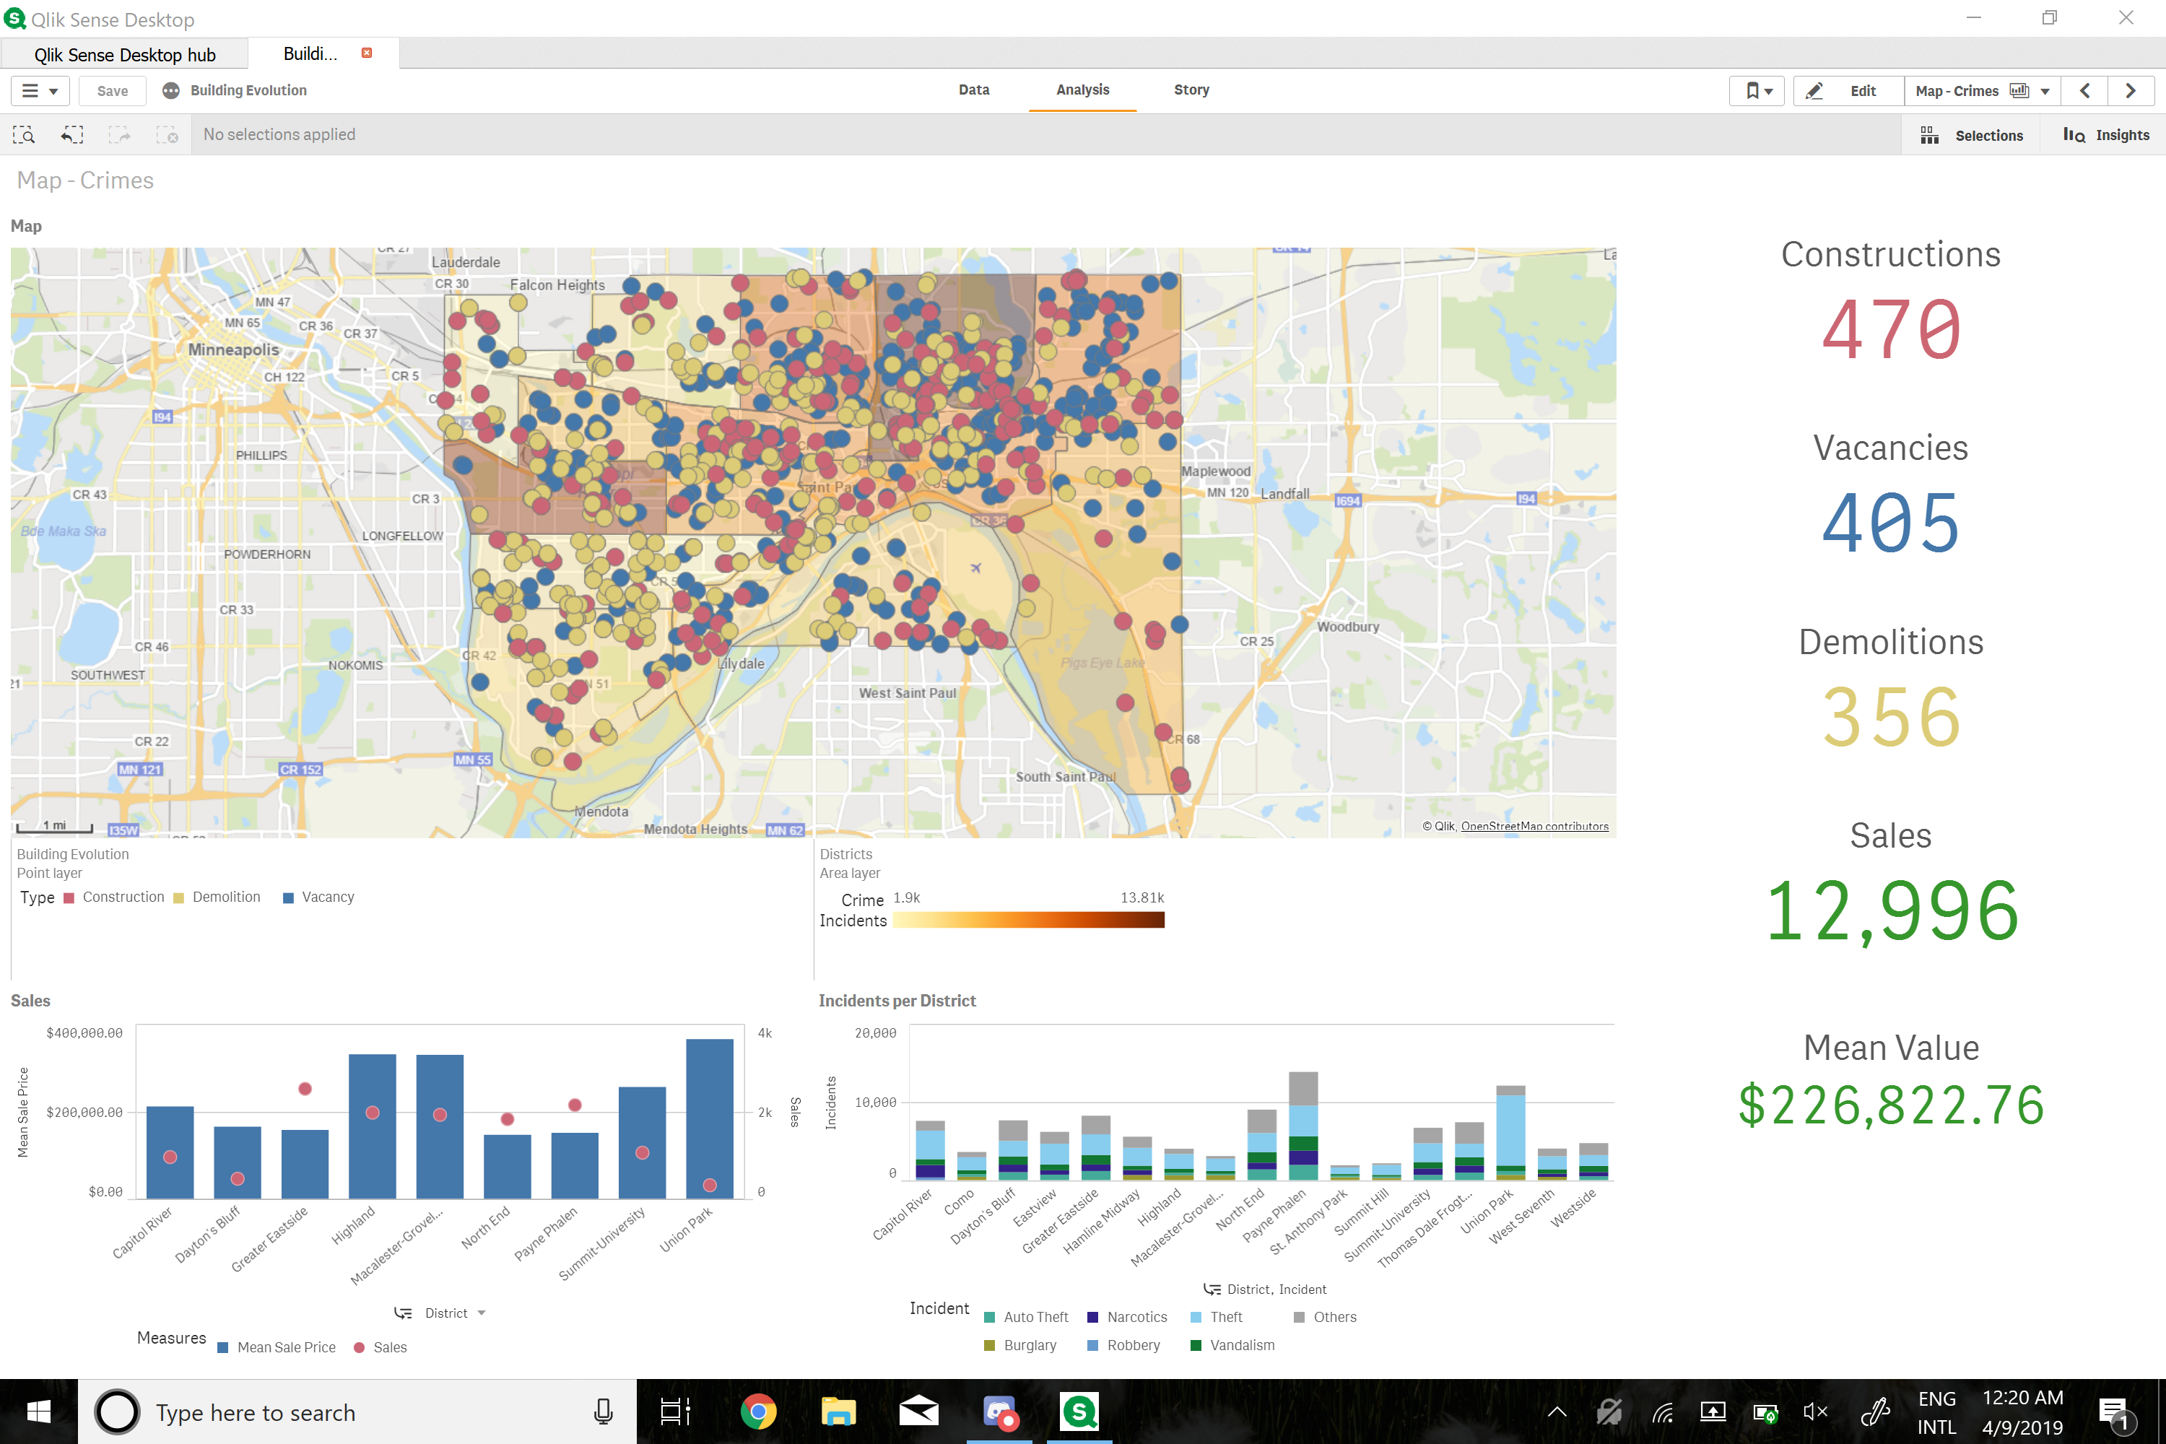
Crime Breakdown by Type

Slide 7
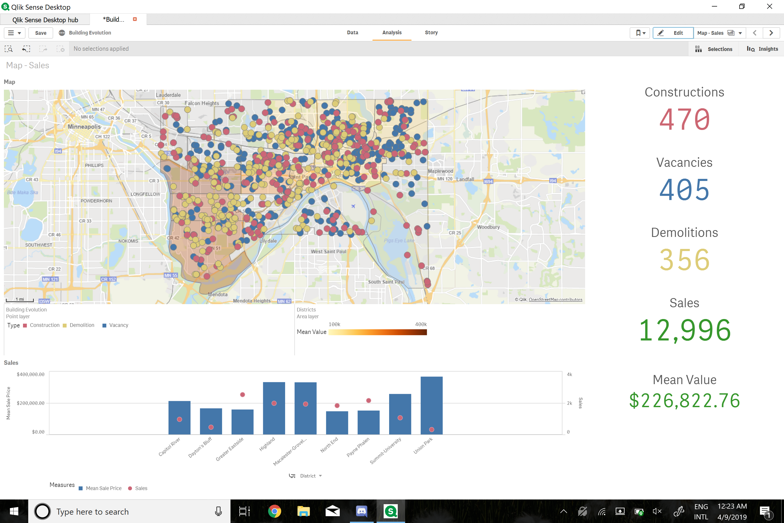
Property Sales Map

Slide 8
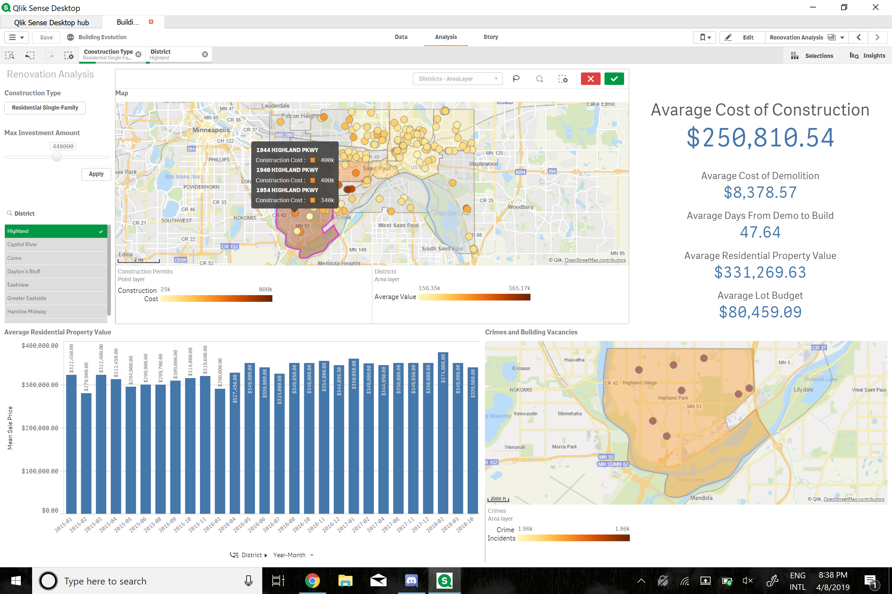
Filter Data by District

Slide 9
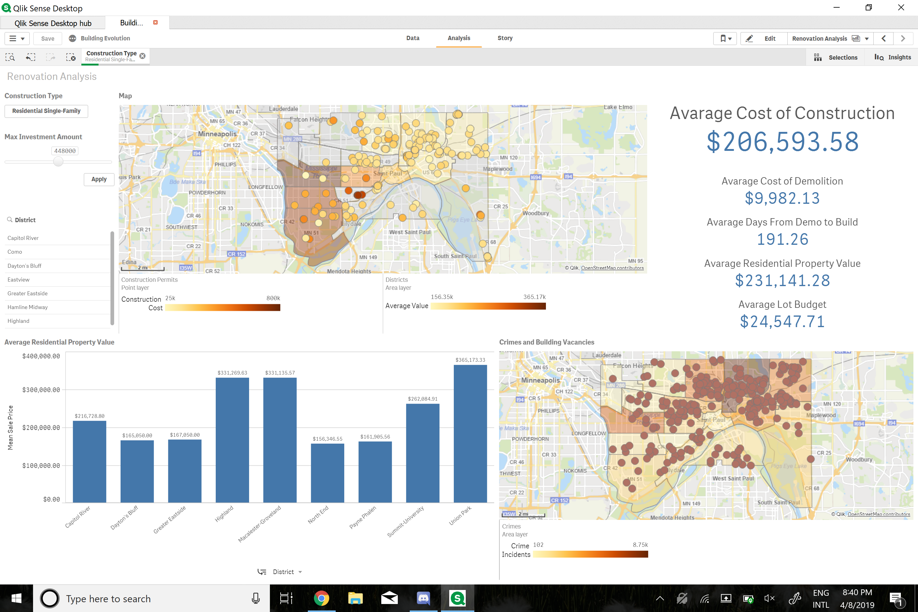
Filter Data by District

Slide 10
Thank You
We welcome all feedback!

